Slide 1

Project on Machine Learning
NAME – BARNALI CHAKRABORTY
Stream-Computer Science And Engineering
Year of Passing-2022, Sec-B Class Roll No-83
University Roll No:10900118097

Slide 2
Covid 19 – The Increasing Pandemic In India
Coronavirus is an infectious disease caused by severe acute respiratory syndrome (SARS COV-2).Common symptoms include fever,cough,fatigue,shortness of breath and loss of smell and taste.While majority of cases causes respiratory symptoms,some progress to acute respiratory distress syndrome and may cause multi organ failure,septic shock and blood clots. The virus is primarily spread between people in close proximity most often via small droplets produced by coughing and also people may get affected by touching contaminated surface.The standard method of diagonisis is by time reverse transcription polymerase chain reaction(rRT-PCR)from a nasopharynx swab.Chest CT imaging may also be hepful.

Slide 3
Aims And Objectives Of Project
While the authorities claimed that the 10-day lockdown was a success because they managed to test the maximum number of people and in creased bed capacity for COVID-19 patients,the situation on ground has taken an alarming turn.Ventilator support beds are over and only a few beds with oxygen remain.Even the critical patients are struggling for beds. So this project is done aiming to get a rough estimate of the requirement of covid beds as per records.

Slide 4
Brief Description Of Project
In this project at first three datasets are taken as no of days,no of beds and no patients. After that the dataset is divided into 90% training and 10% testing datasets.After polynomial regression is used which is a form of regression analysis in which relationship between independent variable x and dependent variable y is modelled as an nth degree polynomial in x.Then a graph is plotted on the given dataset,predicting the nature of the graph.Here, no of beds are plotted on y axis and no of days on x axis.Finally the estimated value of the no of beds are predicted.

Slide 5
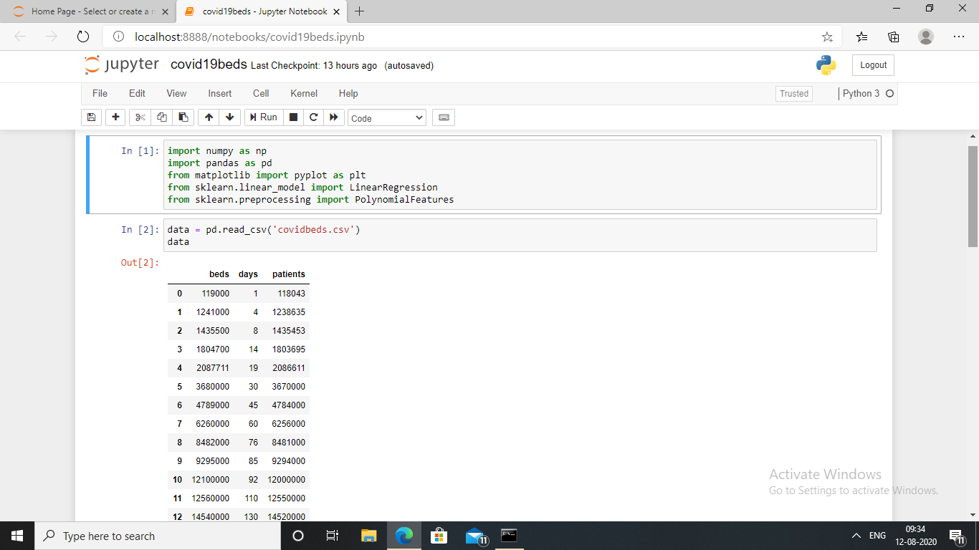

Slide 6
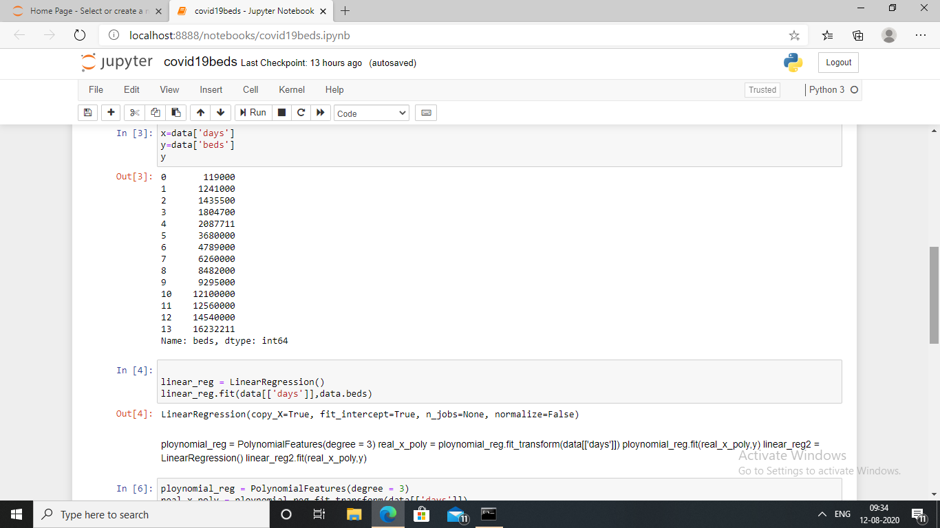

Slide 7
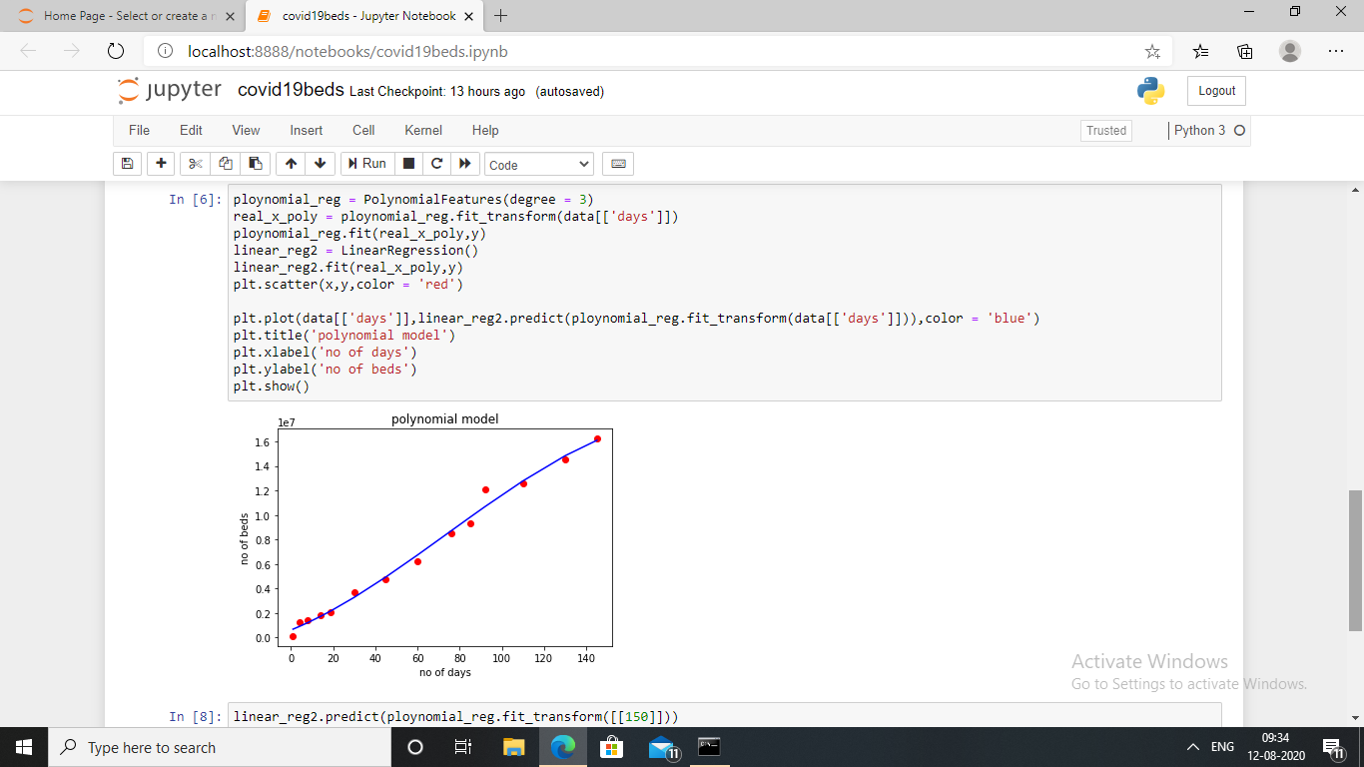

Slide 8
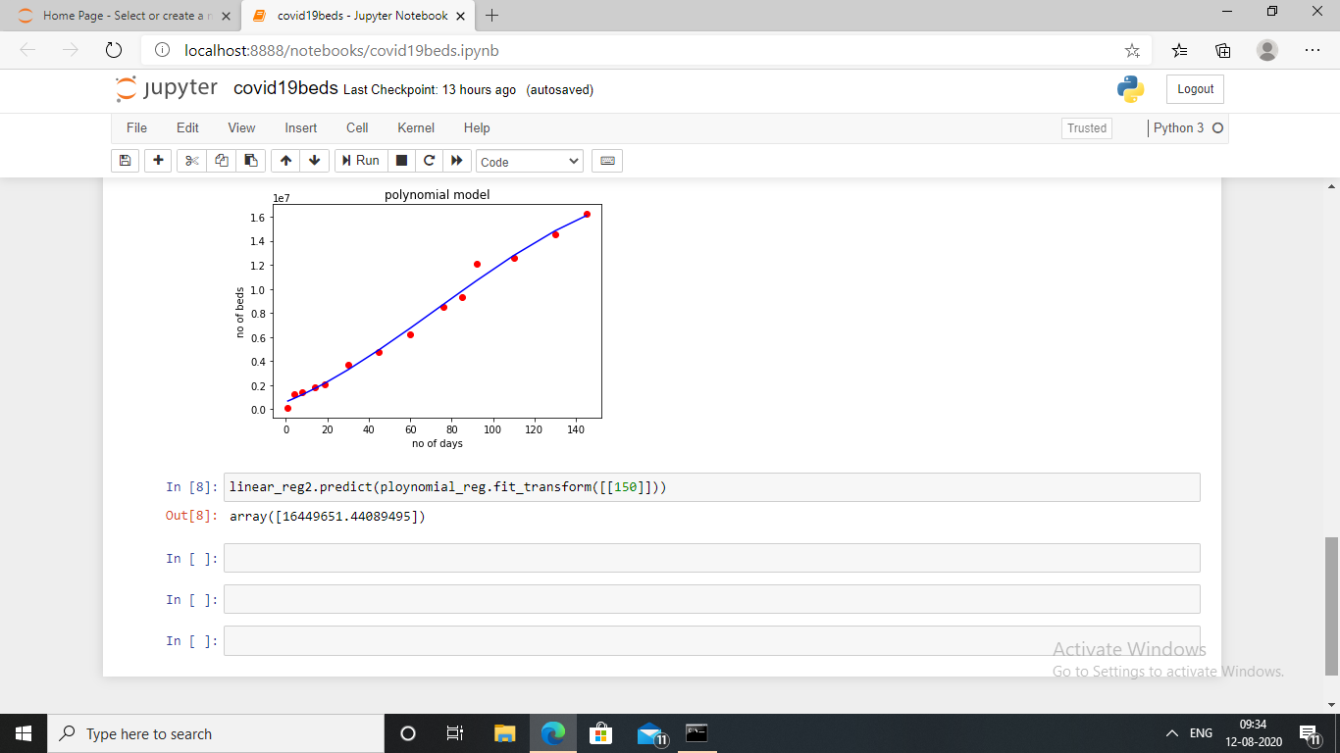

Slide 9
THANK YOU

